Slide 1
Private Signaling
Varun Madathil (North Carolina State University)
Alessandra Scafuro (North Carolina State University)
Istvan Andras Seres (Eotvos Lorand University)
Omer Shlomovits (ZenGo X)
Denis Varlakov (ZenGo X)

Slide 2


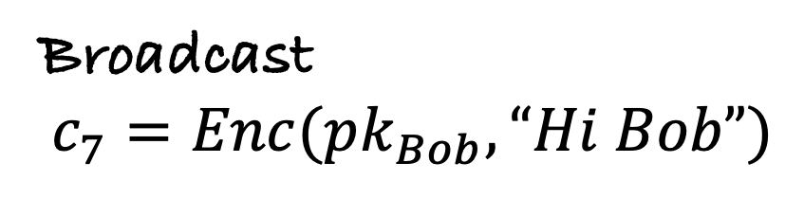


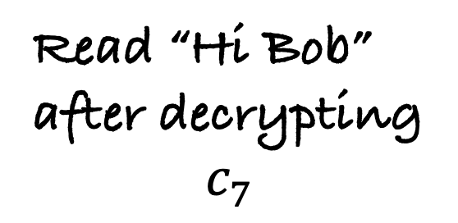
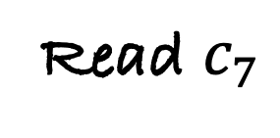
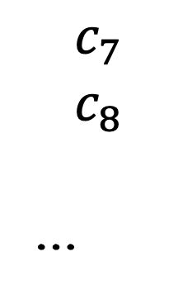
Anonymous Messaging – the setting
$$c_{1}$$
$$c_{2}$$
$$c_{3}$$
Read $c_{7}$
$$c_{4}$$
$$c_{5}$$
$$c_{6}$$
Read “Hi Bob”
after decrypting
$$c_{7}$$
$$c_{7}$$
$$c_{8}$$
…
Broadcast
$$c_{7}=Enc(pk_{Bob},“Hi Bob”)$$

Slide 3

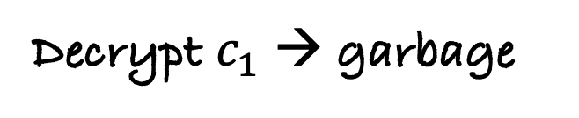
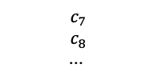


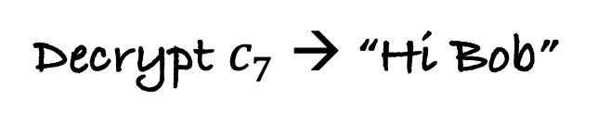
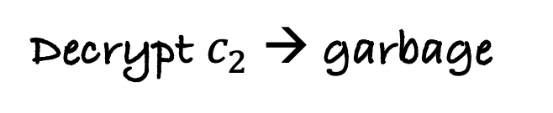
Retrieving the message – 1st naïve approach
Hey bro, can you send me the latest state of the blockchain
Ah, finally my message!
Sure bro
$$c_{1}$$
$$c_{2}$$
$$c_{3}$$
$$c_{4}$$
$$c_{5}$$
$$c_{6}$$
Decrypt $c_{1}$ → garbage
$$c_{7}$$
$$c_{8}$$
…
Decrypt $c_{2}$ → garbage
.
.
.
Decrypt $c_{7}$ → “Hi Bob”

Slide 4

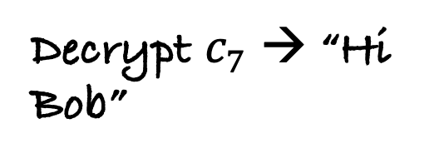
Retrieving the message – 2nd naïve approach
Sure bro
Hey bro, here’s my private key can you check if there are any messages for me?
Btw the message says ”Hi Bob”
$$c_{1}$$
$$c_{2}$$
$$c_{3}$$
$$c_{4}$$
$$c_{5}$$
$$c_{6}$$
$$c_{7}$$
$$c_{7}$$
$$c_{8}$$
…
Decrypt $c_{7}$ → “Hi Bob”

Slide 5


The tension between anonymity and efficiency
Give the server your keys
efficiency
Download the
entire blockchain
anonymity

Slide 6
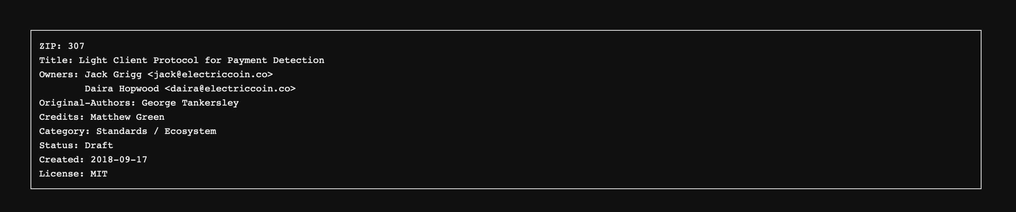
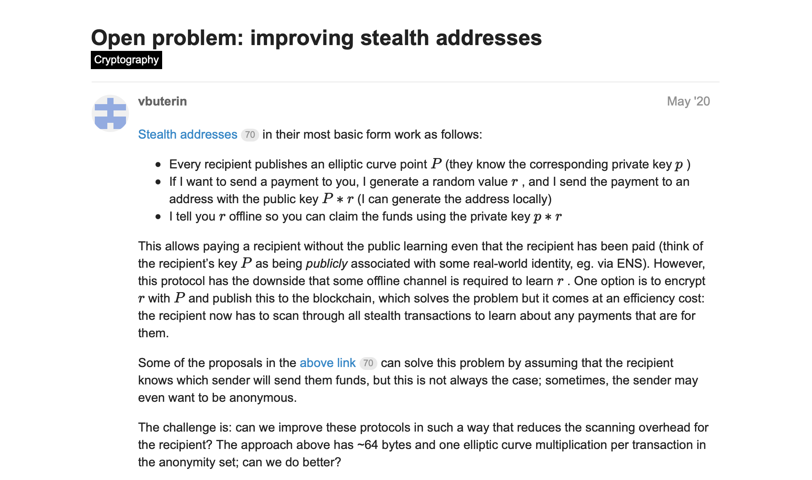

Slide 7
What do we want?

Slide 8

The actors
Sender
Receiver
Signaling service

Slide 9
Ah looks like my message is at the 10th position
My message for Bob is at location 10, let me send a signal about the location
Write
Receiver
Read
So many signals, let me process them one by one
Retrieve
Sender
Process
Signaling service

Slide 10
Efficiency
Privacy
Only writes to
the blockchain
O(1) work per
message sent
Sender
Only talks to
the server.
O(1) work per
message received
No one else learns
info on signals
Receiver
Only reads the
Blockchain and returns signals to receivers
Knows when a receiver retrieves messages
But does not learn location of messages
Signaling service
*
*We assume rational behavior, that the signaling service will do its task and process signals

Slide 11


General approach – with no privacy
Table of signals
 | 2 | 6 | 9
 | 1 | 4 | 5 | 12
 | 3 | 8 | 10 | 11
SEND:
, 13

Slide 12
General approach – with no privacy
Table of signals
 | 2 | 6 | 9
 | 1 | 4 | 5 | 12
 | 3 | 8 | 10 | 11
SEND:
13
READ

Slide 13
General approach – with no privacy
Table of signals
 | 2 | 6 | 9 | 13
 | 1 | 4 | 5 | 12
 | 3 | 8 | 10 | 11
PROCESS
SEND:
13

Slide 14
General approach – with no privacy
Table of signals
 | 2 | 6 | 9 | 13
 | 1 | 4 | 5 | 12
 | 3 | 8 | 10 | 11
RETRIEVE
SEND:
13
: (2,6,9,13)

Slide 15
For privacy →
obliviously update an encrypted table

Slide 16
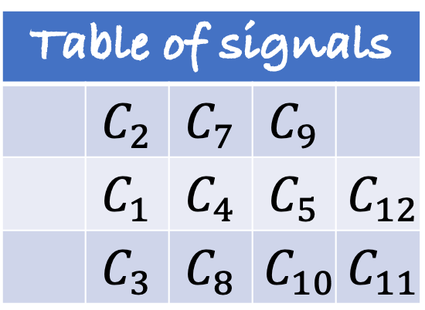
Signaling service maintains an encrypted table
Table of signals
 | $$C_{2}$$ | $$C_{7}$$ | $$C_{9}$$
 | $$C_{1}$$ | $$C_{4}$$ | $$C_{5}$$ | $$C_{12}$$
 | $$C_{3}$$ | $$C_{8}$$ | $$C_{10}$$ | $$C_{11}$$

Slide 17
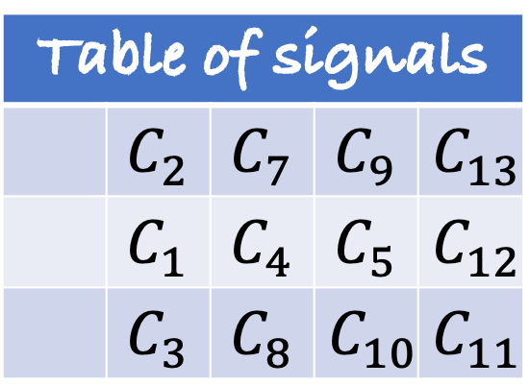
Observation #1
Table of signals
 | $$C_{2}$$ | $$C_{7}$$ | $$C_{9}$$ | $$C_{13}$$
 | $$C_{1}$$ | $$C_{4}$$ | $$C_{5}$$ | $$C_{12}$$
 | $$C_{3}$$ | $$C_{8}$$ | $$C_{10}$$ | $$C_{11}$$
Must update all the
ciphertexts, else some
information is leaked to the Server.

Slide 18
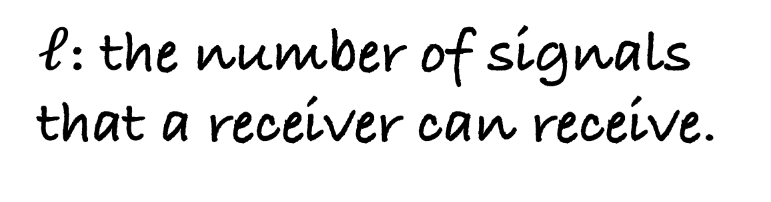
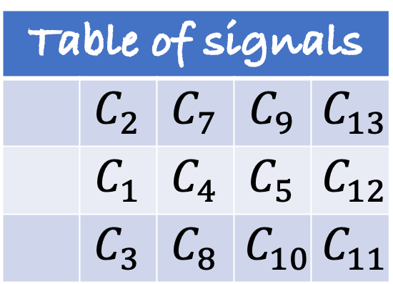

Observation #2
Table of signals
 | $$C_{2}$$ | $$C_{7}$$ | $$C_{9}$$ | $$C_{13}$$
 | $$C_{1}$$ | $$C_{4}$$ | $$C_{5}$$ | $$C_{12}$$
 | $$C_{3}$$ | $$C_{8}$$ | $$C_{10}$$ | $$C_{11}$$
$ℓ$: the number of signals
that a receiver can receive.
$$ℓ$$

Slide 19
How do we accomplish oblivious updates?

Slide 20

Two solutions
How do we accomplish oblivious updates?
Two party
computation
Trusted Execution Environment
(Two non-colluding servers)

Slide 21
Solution based on 2-party computation
Table of signals
 | 2 | 6 | 9 | 0
 | 1 | 4 | 0 | 0
 | 3 | 8 | 10 | 11

Slide 22
Solution based on 2-party computation
Table of signals
 | 4 | 11 | 5 | 13
 | 1 | 7 | 5 | 12
 | 4 | 3 | 9 | 11
Table of signals
 | 6 | 13 | 12 | 13
 | 0 | 3 | 5 | 12
 | 7 | 11 | 3 | 0
XOR of each index in the two tables returns the signal

Slide 23
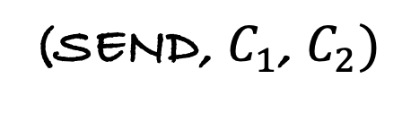



Sending a signal
Signal:
$$C_{1}=Enc_{pk1}\left(11, \right)$$
$$C_{2}=Enc_{pk2}(6, )$$
SEND:
13
$$⊕$$
13
11
$$⊕$$
6
(SEND, $C_{1}$, $C_{2})$

Slide 24
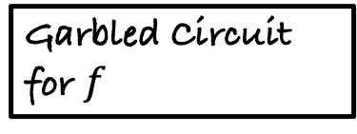
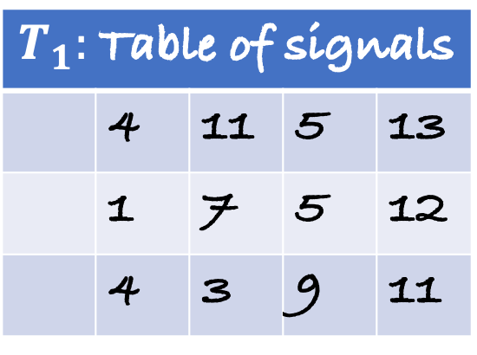
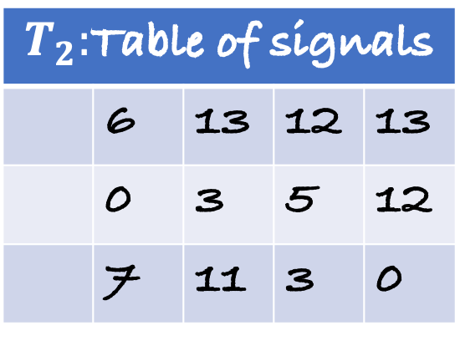
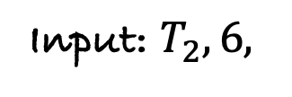
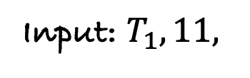
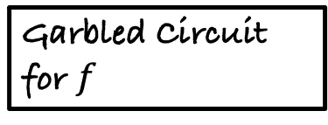
Processing a signal
$T_{1}:$Table of signals
 | 4 | 11 | 5 | 13
 | 1 | 7 | 5 | 12
 | 4 | 3 | 9 | 11
$T_{2}:$Table of signals
 | 6 | 13 | 12 | 13
 | 0 | 3 | 5 | 12
 | 7 | 11 | 3 | 0
Garbled Circuit for $f$
Input: $T_{1}, 11,$
Garbled Circuit for $f$
Input: $T_{2}, 6,$

Slide 25



What does the function $f$ do?
1. At the next available position of
$$⊕$$
$$=$$
insert share of the position
2. Rerandomize the entire table
This ensures that the servers cannot learn anything
about the receiver and the location of the signal.

Slide 26


Retrieval
Retrieve
 | 4 | 11 | 5 | 13
 | 4 | 11 | 5 | 2
$$⊕$$
$$⊕$$
$$⊕$$
$$⊕$$
 | 6 | 13 | 12 | 15
 | 6 | 13 | 12 | 13
 | 2 | 6 | 9 | 13

Slide 27
Related work

Slide 28
Oblivious Message Retrieval (Crypto ‘22)
Follow-up work and makes use of only one server
Based on Fully Homomorphic Encryption
Receiver has to do at least O(log N) work.
PS
efficiency
OMR
PS: Our Work
OMR: Oblivious Message Retrieval
anonymity

Slide 29
Fuzzy Message Detection (CCS ‘21)
Single server construction, where the server has a “fuzzy” detection key that identifies relevant ciphertexts as well as non-matching flag ciphertexts (false positives)
PS
(Tradeoff between
efficiency and privacy)
efficiency
FMD
OMR
PS: Our Work
OMR: Oblivious Message Retrieval
FMD: Fuzzy Message Detection
anonymity

Slide 30
Conclusion
- Present a UC definition for private signaling
- Present two protocols – one based on two-party computation and another that makes use of TEEs
- Our protocols give best efficiency guarantees to the sender and receiver
Future Work
- Come up with constructions to reduce the computation of the server
- remove the assumptions of non-colluding servers or that of TEEs

Slide 31
Thank you!
Full version at: https://eprint.iacr.org/2021/853.pdf
Contact: vrmadath@ncsu.edu

